Slide 1
Deep Learning from Scratch
Theory + Practical
FAHAD HUSSAIN
MCS, MSCS, DAE(CIT)
Computer Science Instructor of well known international Center
Also, Machine Learning and Deep learning Practitioner
For further assistance, code and slide https://fahadhussaincs.blogspot.com/
YouTube Channel : https://www.youtube.com/fahadhussaintutorial

Slide 2
So, What we learn in this course
Supervised Unsupervised Reinforcement Learning
Artificial Neural Network
Regression and Classification
For further assistance, code and slide https://fahadhussaincs.blogspot.com/
YouTube Channel : https://www.youtube.com/fahadhussaintutorial

Slide 3
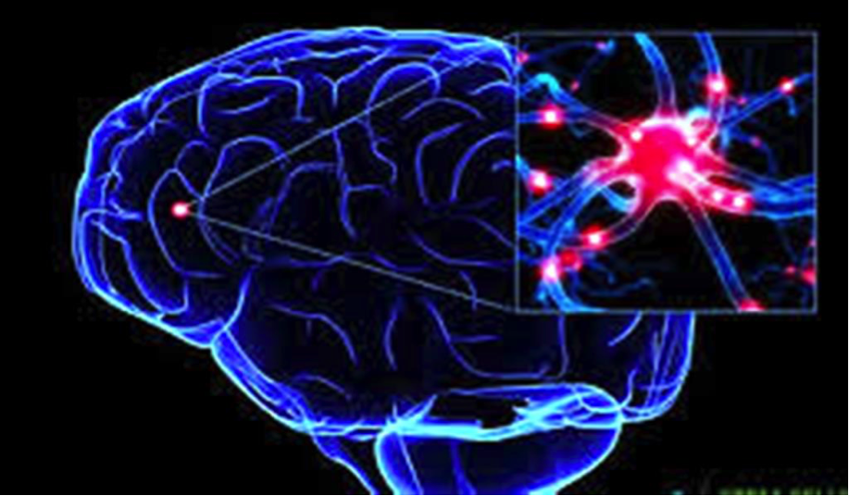
What is Neural
For further assistance, code and slide https://fahadhussaincs.blogspot.com/
YouTube Channel : https://www.youtube.com/fahadhussaintutorial

Slide 4
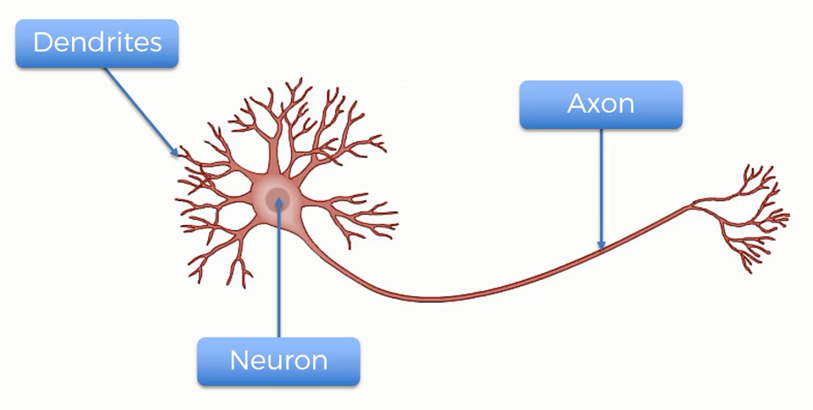
Neural Working
For further assistance, code and slide https://fahadhussaincs.blogspot.com/
YouTube Channel : https://www.youtube.com/fahadhussaintutorial

Slide 5
Perceptron in deep learning
For further assistance, code and slide https://fahadhussaincs.blogspot.com/
YouTube Channel : https://www.youtube.com/fahadhussaintutorial

Slide 6
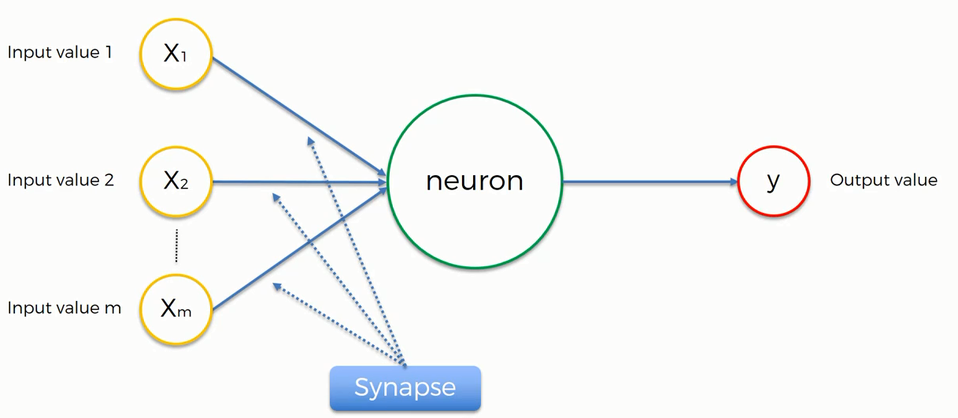

Artificial Neural Network
Normalize/Standardize
$$\sum_{i=x}^{m}{wi xi}$$
Applying Activation Function
For further assistance, code and slide https://fahadhussaincs.blogspot.com/
YouTube Channel : https://www.youtube.com/fahadhussaintutorial

Slide 7
Thank You!
For further assistance, code and slide https://fahadhussaincs.blogspot.com/
YouTube Channel : https://www.youtube.com/fahadhussaintutorial

